Slide 1
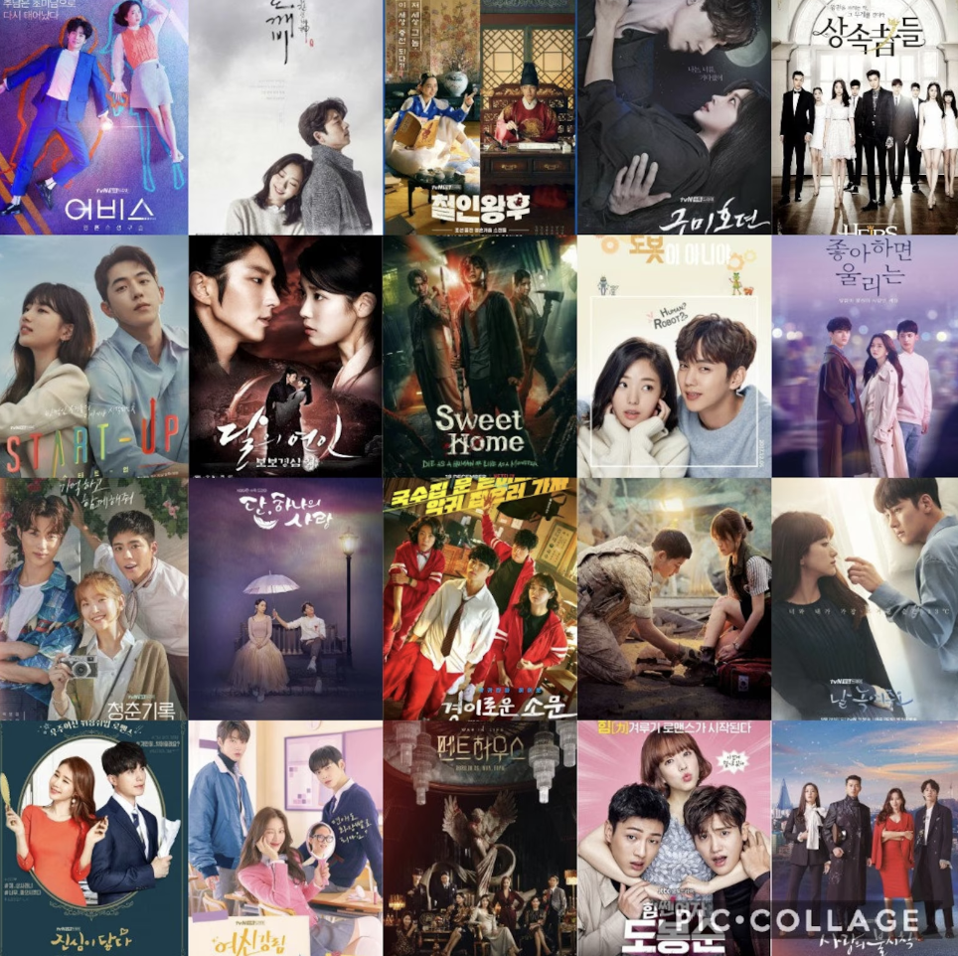
Korean Drama Recommendation System
DATA606- Capstone Project in Data Science
Under the guidance of Professor Dr. Chaojie Wang
By: Sunjung Kim
KA62774

Slide 2
Background
Korean TV dramas, commonly referred to as K-dramas, have enjoyed widespread popularity across Asia since the 1990s. It's only in the past decade that this genre has made significant inroads into the entertainment markets of Europe and the Americas, subsequently garnering a substantial following among Western audiences and establishing itself as a global entertainment trend.
The use of recommender systems is prevalent in the digital marketplace, particularly in the realms of online streaming and shopping. These systems are adept at predicting products, movies, or shows that a consumer is likely to purchase or enjoy. Major companies like Netflix and Amazon employ these systems to enhance user experience by guiding them to content that aligns with their interests and viewing history.
In response to the increasing global interest in K-dramas, this recommender system is specifically designed to suggest Korean dramas. The recommendations are based on an analysis of the dramas that users have previously viewed by synopsis, providing a tailored and relevant selection of K-dramas that align with their viewing preferences.
Notes:
K-dramas, popular in Asia since the 1990s, have recently gained a significant following in Europe and the Americas. Recognizing this global trend, this recommender system is crafted to suggest Korean dramas based on users’ interests by K-drama synopsis/Cast/Genres. This system, akin to those used by Netflix and Amazon, offers personalized K-drama recommendations by analyzing watched dramas' synopses, ensuring viewers find content that resonates with their preferences.

Slide 3
Introduction
Analyzing patterns of similarity in K-dramas can provide a list of K-drama recommendations.
Recommendation systems involve predicting user preferences for unseen items.
Notes:
By analyzing similarity patterns in K-dramas, our system can recommend new titles to viewers. This process involves predicting which dramas users might like based on their previous choices, ensuring a personalized viewing experience.

Slide 4
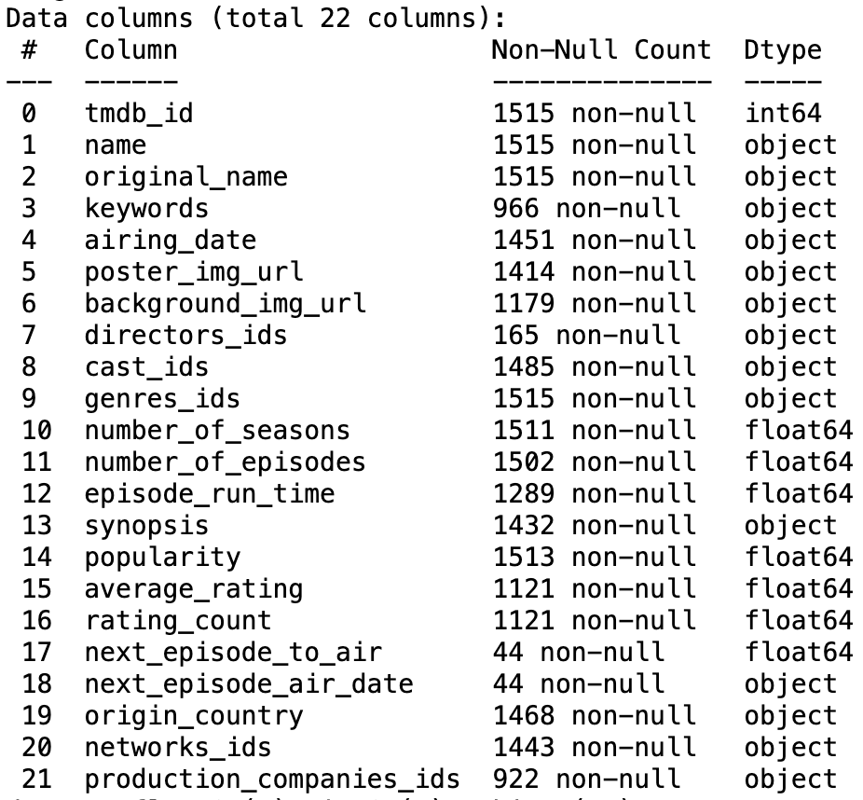
Data and Dataset
Data dictionary:
Data sources: TMDB website
Data size: 94.8 KB
Data shape (# of rows and # columns): 1515,8
Time Period: 1983-2023
Which variable/column will be your target/label in your ML model?
Target Column = tmbd_id
Which variables/columns may be selected as features/predictors for your ML models?
Feature columns = 'name', 'cast', 'genres’, 'synopsis'

Slide 5
Research Questions:
What are the most popular genres in South Korean dramas?
What are the most well-known Network company in South Korea?
Can I get a recommendation list based on the content?
What are the most common keywords associated with successful K-dramas?

Slide 6
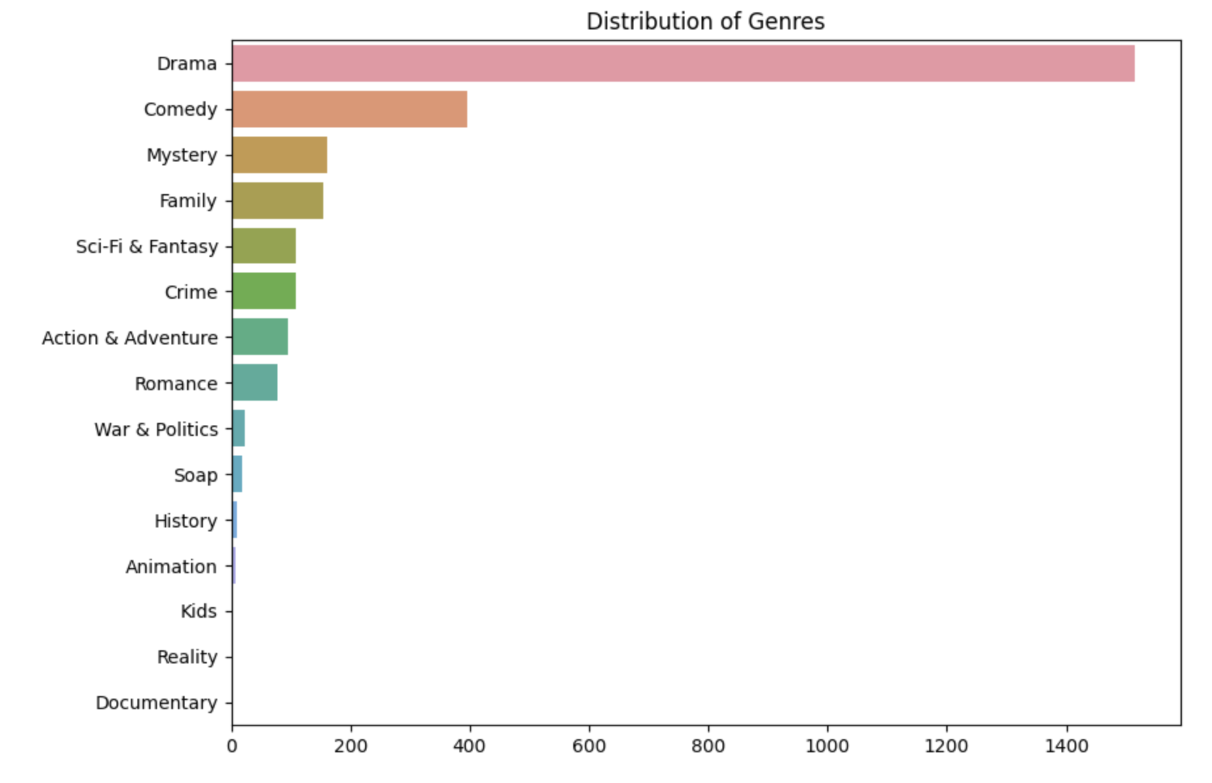
EDA

Slide 7
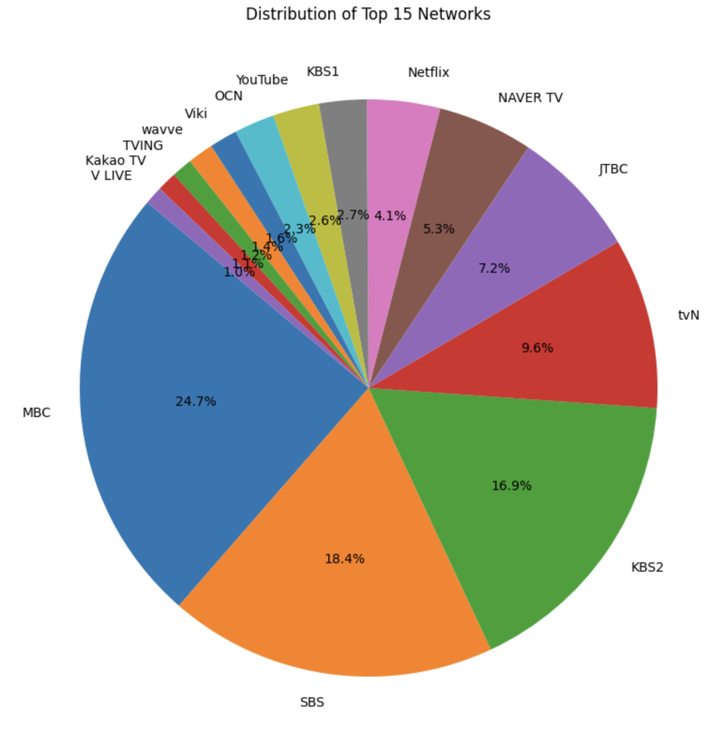
Results

Slide 8
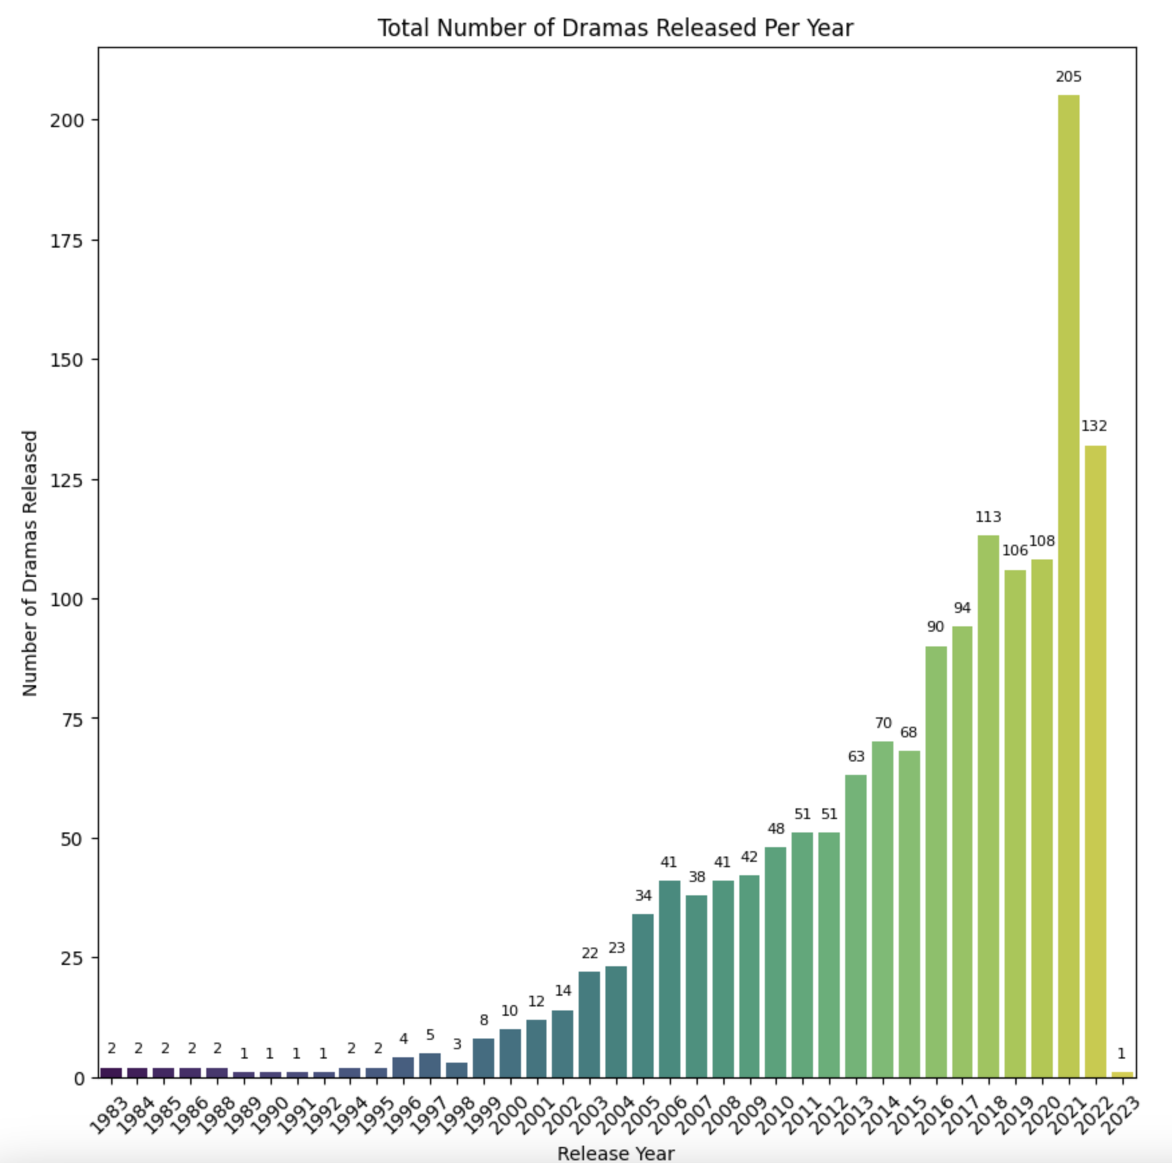
Results:

Slide 9
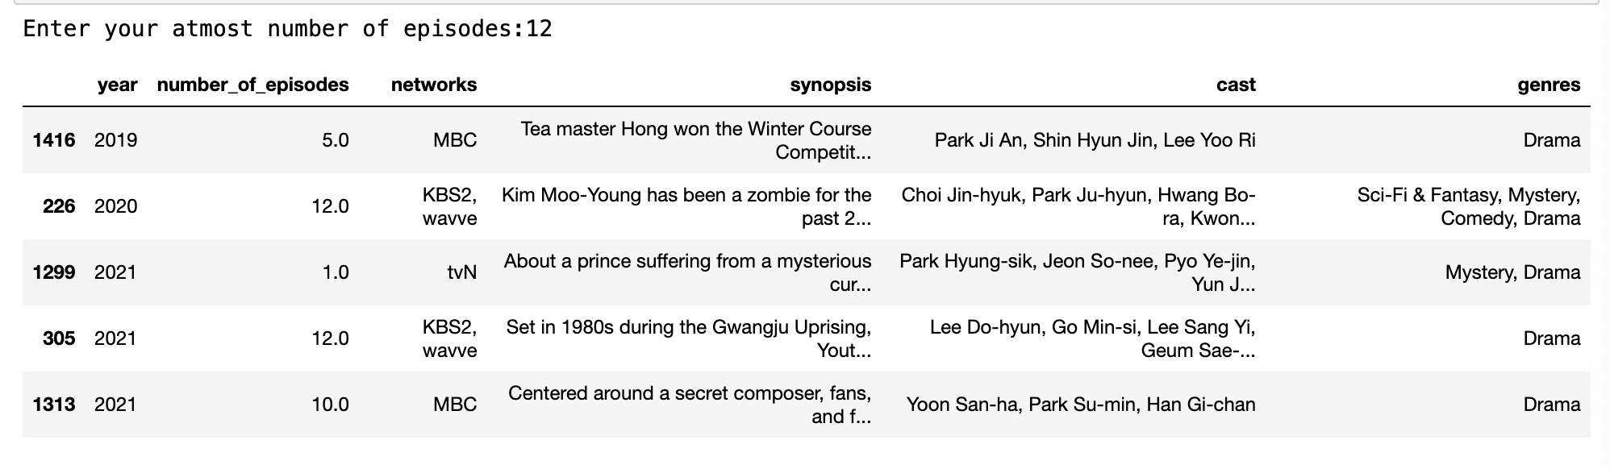
Results(Contd.)

Slide 10
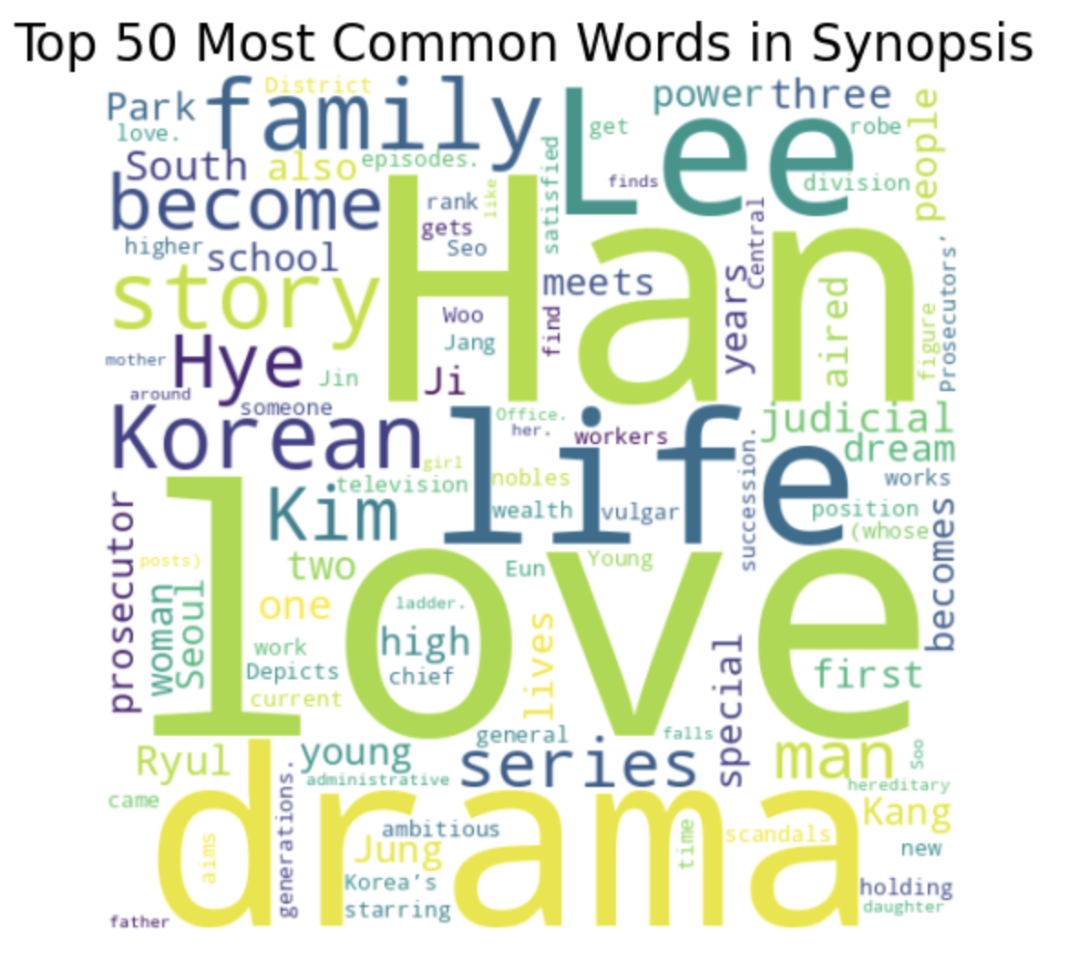
Results(Contd.)

Slide 11
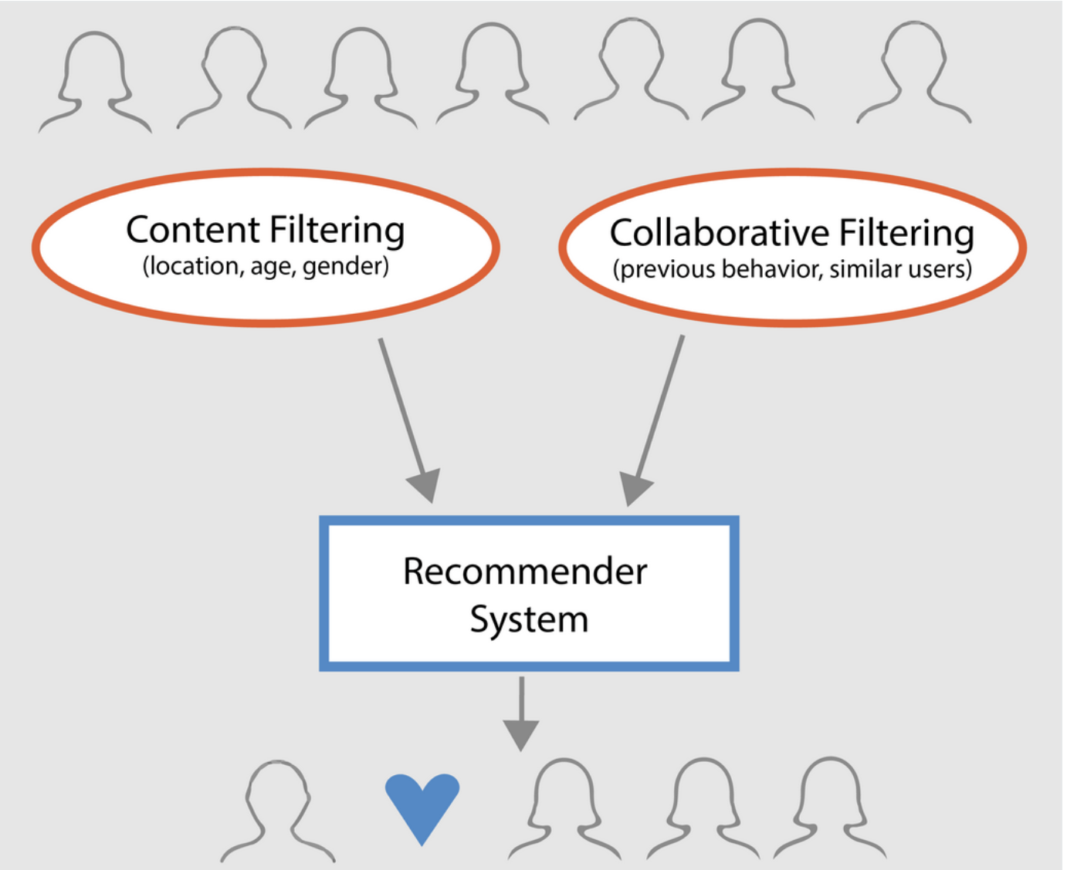
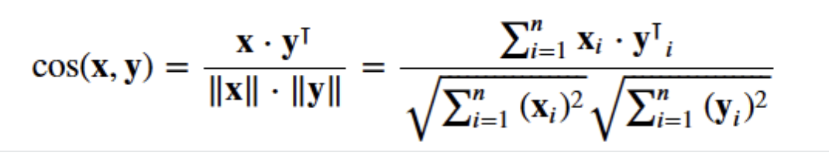
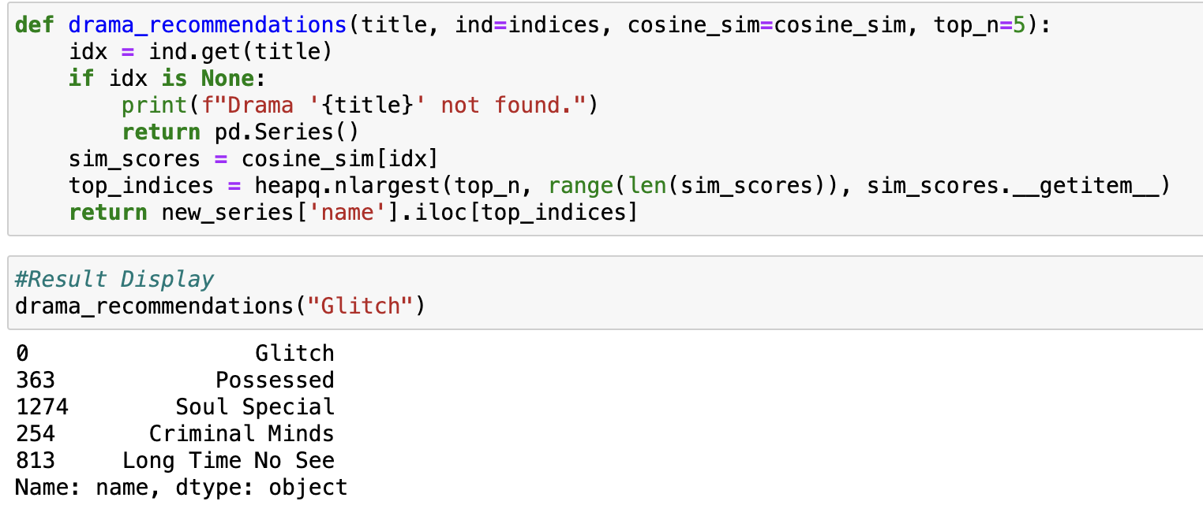
Content-Based Recommendation
Notes:
After Removing stop words
Conversion of text data in the "Synopsis" column into numerical vectors using TF-IDF
Calculation of Cosine Similarity between the vectors generated by TF-IDF for recommendation.
In the create_indices function, we generate a list of unique dramas from the DataFrame for recommendation..
* This function, **drama_recommendations**, takes the title of a Korean drama, a set of precomputed indices, a cosine similarity matrix, and a parameter for the number of top recommendations. It finds the index of the given drama, retrieves its cosine similarity scores with other dramas, identifies the top N similar dramas, and returns the names.

Slide 12
Attributes Recommendation
The aim is to refine the system's ability to provide accurate recommendations by capturing nuanced aspects of the content. To achieve this, the recommender system will be developed with a focus on several key metadata elements. These include:
The top actors featured in the K-Drama.
The synopsis of K-Drama
The genres associated with the K-Drama.
By integrating these the recommender system is expected to deliver more precise and relevant suggestions, aligning closely with the individual preferences and interests of the users.
Notes:
The goal is to enhance our K-drama recommender system's accuracy by focusing on key content features. We'll consider the top actors, the synopsis, and the genres of each K-drama. This approach aims to provide precise, user-aligned recommendations by capturing the subtle details of the content.

Slide 13
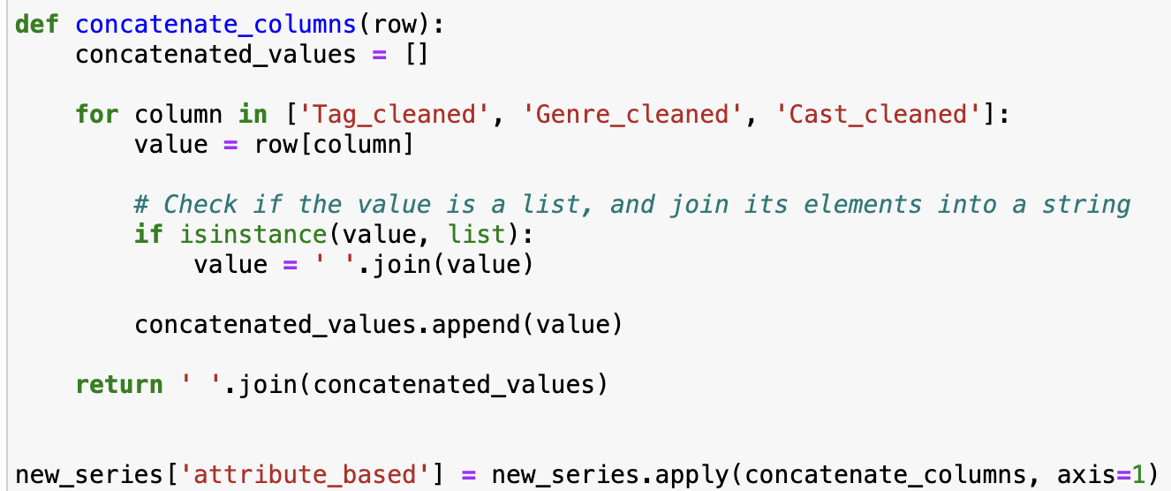
Attributes Recommendation(Con’t)
the concatenated column attribute_based in text form so here we convert it to numerical vectors for recommendation with CountVectorizer.
Calculation of Cosine Similarity of count_matrix_attribute.
Notes:
concatenate above three column Genre_cleaned, Genre_cleaned, and Genre_cleaned.
the concatenated column attribute_based in text form so here we convert it to numerical vectors for recommendation with CountVectorizer
Calculation of Cosine Similarity of count_matrix_attribute

Slide 14
Streamlit App

Slide 15
Challenges
Data Quality and Availability: Address challenges related to sourcing and maintaining a high-quality, diverse dataset of Korean dramas, including issues with incomplete or biased data.
Algorithm Complexity: Discuss the complexities in developing and tuning recommendation algorithms, especially in catering to diverse user preferences.
Cultural Nuances: Highlight the challenge of understanding and integrating cultural nuances into the recommendation logic, ensuring relevance and sensitivity to different audiences.
Notes:
Data Quality and Availability: Ensuring a diverse, high-quality dataset of K-dramas is challenging, particularly with issues like incomplete or biased data.
Algorithm Complexity: Developing algorithms that cater to diverse user preferences is complex, requiring careful tuning and testing.
Cultural Nuances: Integrating cultural nuances into recommendation logic is crucial for relevance and sensitivity, presenting a significant challenge.

Slide 16
THANK YOU!

